Slide 1
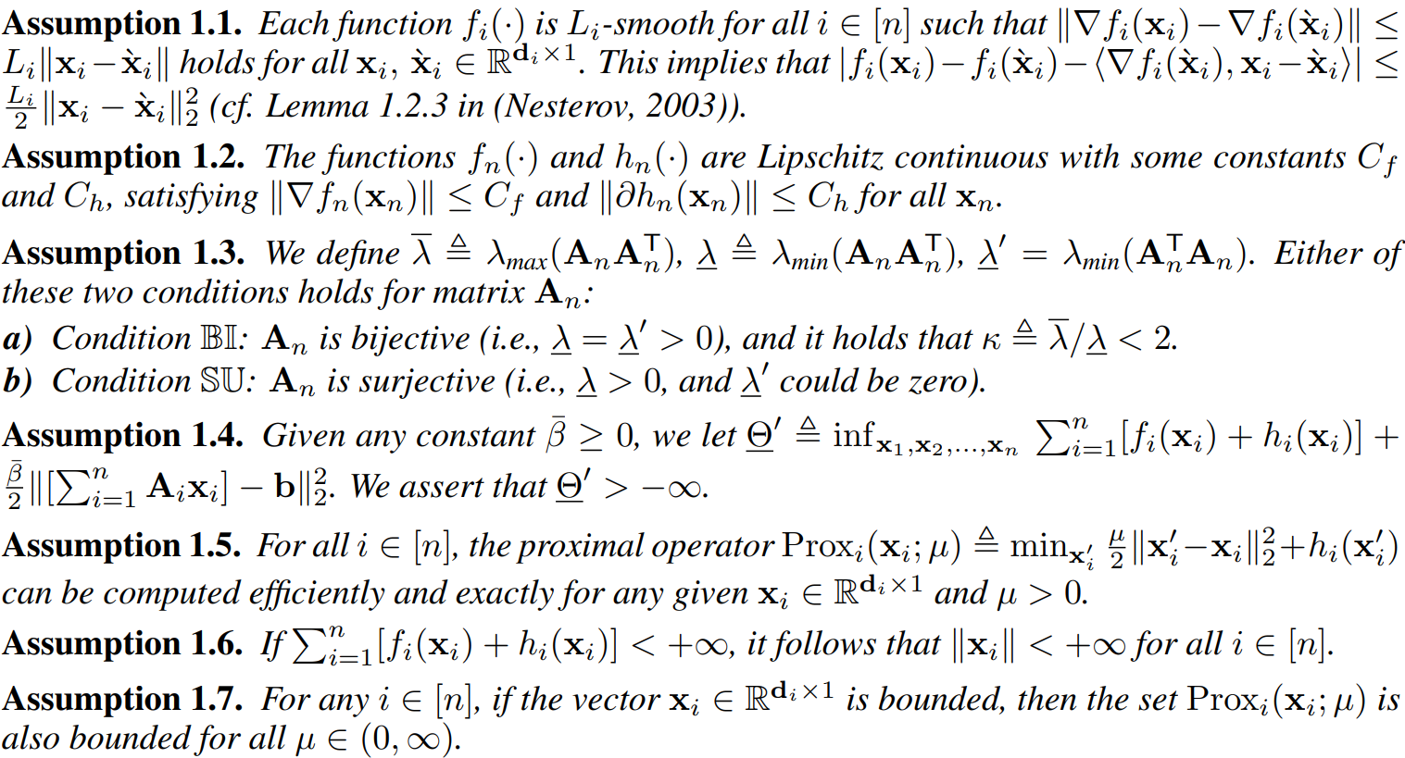
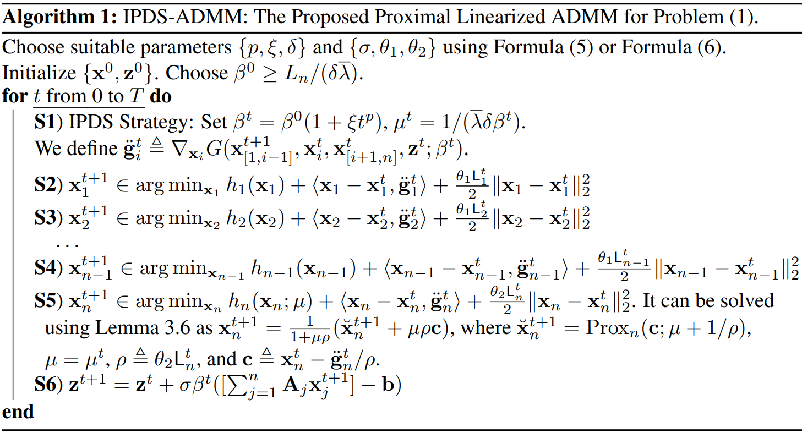
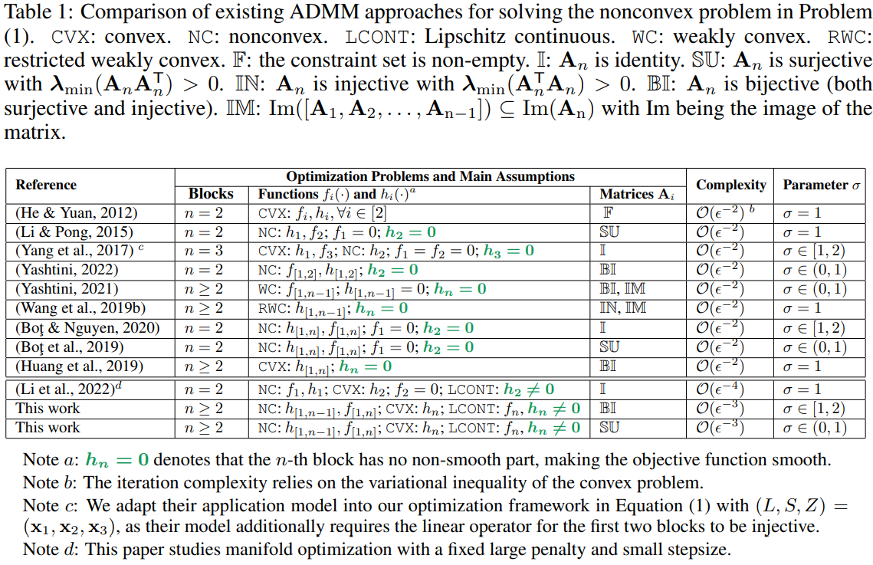
ADMM for Nonconvex Optimization under Minimal Continuity Assumption Ganzhao Yuan Peng Cheng Laboratory, China
1. Multi-block Nonconvex Nonsmooth Composite Optimization Problem
2. Assumptions
3. Comparisons With Existing Works
4. The Proposed Algorithm
Smoothing the nonsmooth function of the last block:
The resulting augmented Lagrangian function:
Our Key Strategy: Increasing Penalization and Decreasing Smoothing
The Proposed IPDS-ADMM:
On Choosing the Parameters:
5. Iteration Complexity
Controlling Dual using Primal:
The Associated Lyapunov Function:
A Summerable Property:
Approximate Critical Point
The Complexity Result
6. Experiment Results
Conclusions:
(a) Sub-Grad tends to be less efficient in comparison to other methods.
(b) SPGM, utilizing a variable smoothing strategy, generally demonstrates slower performance than the multiplier-based variable splitting method. This observation corroborates the widely accepted notion that primal-dual methods are typically more robust and quicker than primal-only methods.
(c) The proposed IPDS-ADMM consistently achieves the lowest objective function values among all methods examined.

