Slide 1
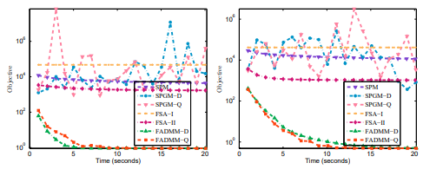
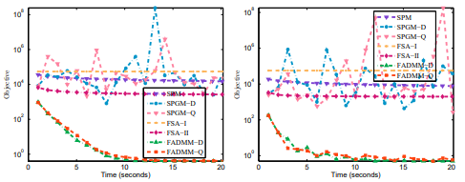
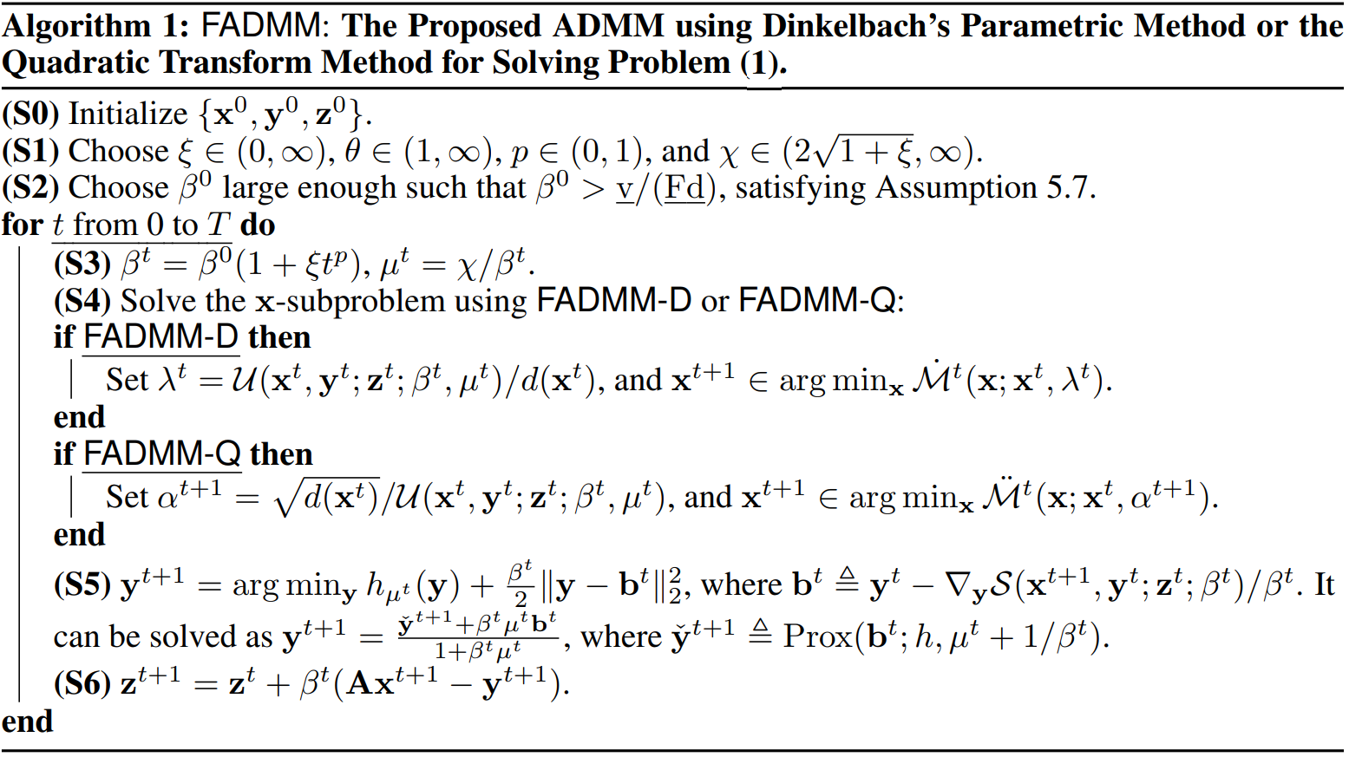
ADMM for Structured Fractional Minimization Ganzhao Yuan Peng Cheng Laboratory, China
1. Nonconvex Nonsmooth Fractional Minimization Problem
2. Assumptions
3. Comparisons With Existing Works
Algorithms in Limited Scenarios
Dinkelbach’s Parametric Algorithm (DPA)
Quadratic Transform Algorithm (QTA)
Linearized DPA and Linearized DPA
General Algorithms for Solving the Main Problem
Subgradient Projection Methods
Smoothing Proximal Gradient Methods
Full Splitting Algorithm (FSA)
4. Applications
Sparse Fisher Discriminant Analysis
Sharpe ratio maximization
Signal-to-noise ratio maximization
5. The Proposed Algorithm
Smoothing the nonsmooth function h(y):
The resulting augmented Lagrangian function:
FADMM-D variant:
FADMM-Q variant:
Our Key Strategy: Increasing Penalization and Decreasing Smoothing
The Proposed FADMM Algorithm
Majorization Technique
Majorization Technique
The Main Algorithm
On Choosing the Parameters:
6. Iteration Complexity
First-Order Optimality Conditions
Controlling Dual using Primal
The Associated Lyapunov Function
FADMM-D:
FADMM-Q:
A Summerable Property
Approximate Critical Point
The Complexity Result
7. Applications and Experiment Result
Sparse Fisher Discriminant Analysis
Robust Sharpe Ratio Maximization
Robust Sparse Recovery
Experiment Results
Conclusions:
(a) SPM tends to be less efficient in comparison to other methods.
(b) SPGM-D and SPGM-Q, utilizing a variable smoothing strategy,
generally demonstrates better performance than SPM.
(c) The proposed FADMM-D and FADMMQ generally exhibit similar performance, both achieving the lowest objective function values among all the methods examined. This supports the widely accepted view that primal-dual methods are generally more robust and faster than primal-only methods.
(d) The proposed FADMM-D and FADMM-Q still outperform FSA, which uses a sufficiently small step size to ensure convergence.

